Slide 1

Welcome!
Grab a drink, food, and chat with your fellow makers.
Jan 23, 2018

Slide 2

What is Open Hardware?
Open (Source) Hardware, or OSHW, is “hardware whose design is made publicly available so that anyone can study, modify, distribute, make, and sell the design or hardware based on that design.”

Slide 3
Introductions
Name
Day Job / Other Job
Open / Hardware Experience
Coolest present you received recently

Slide 4
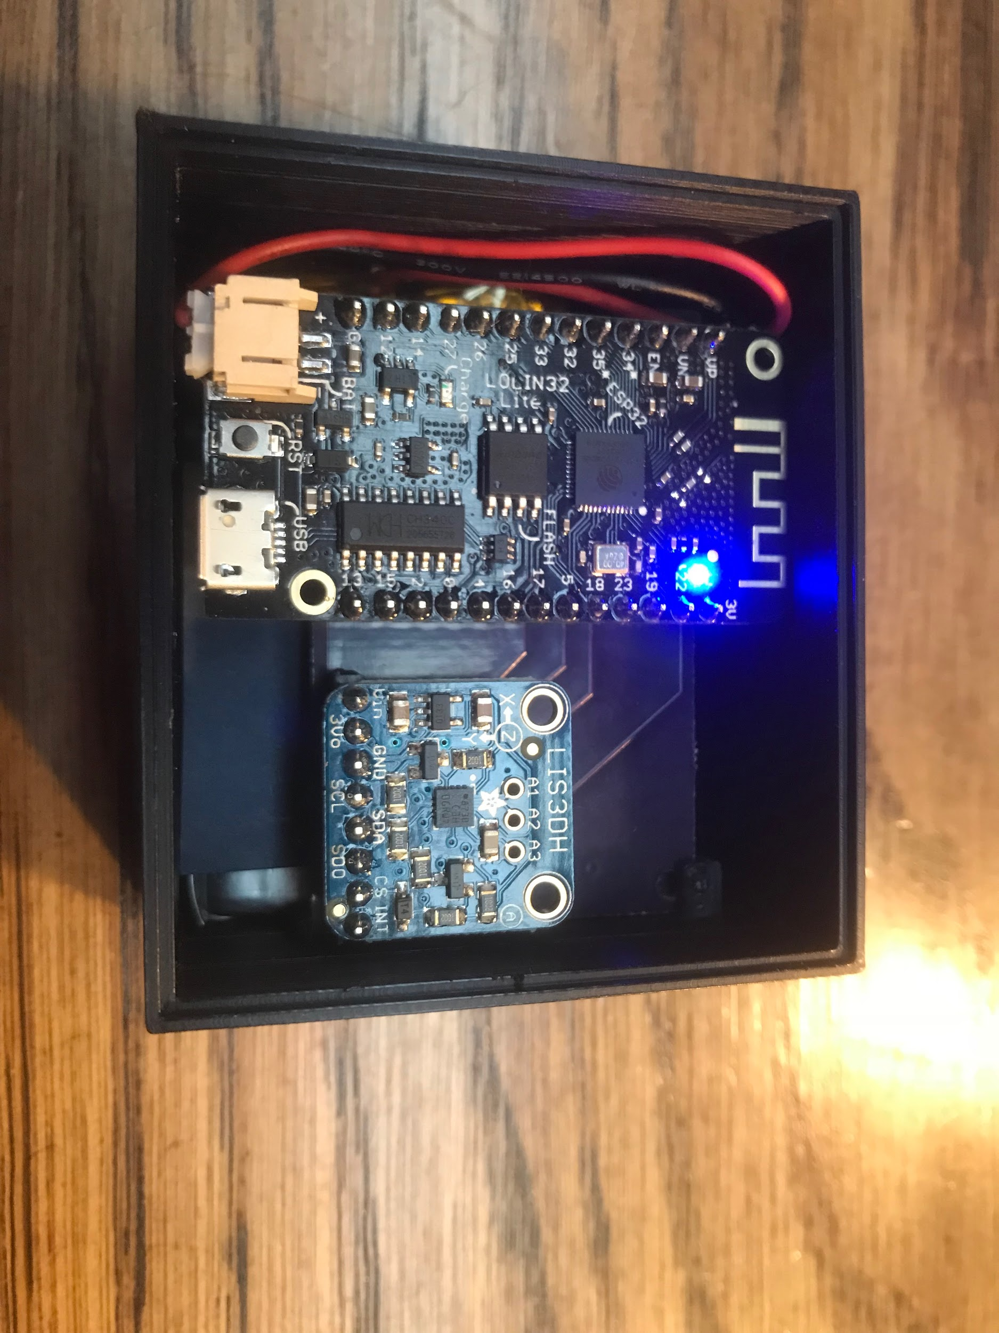
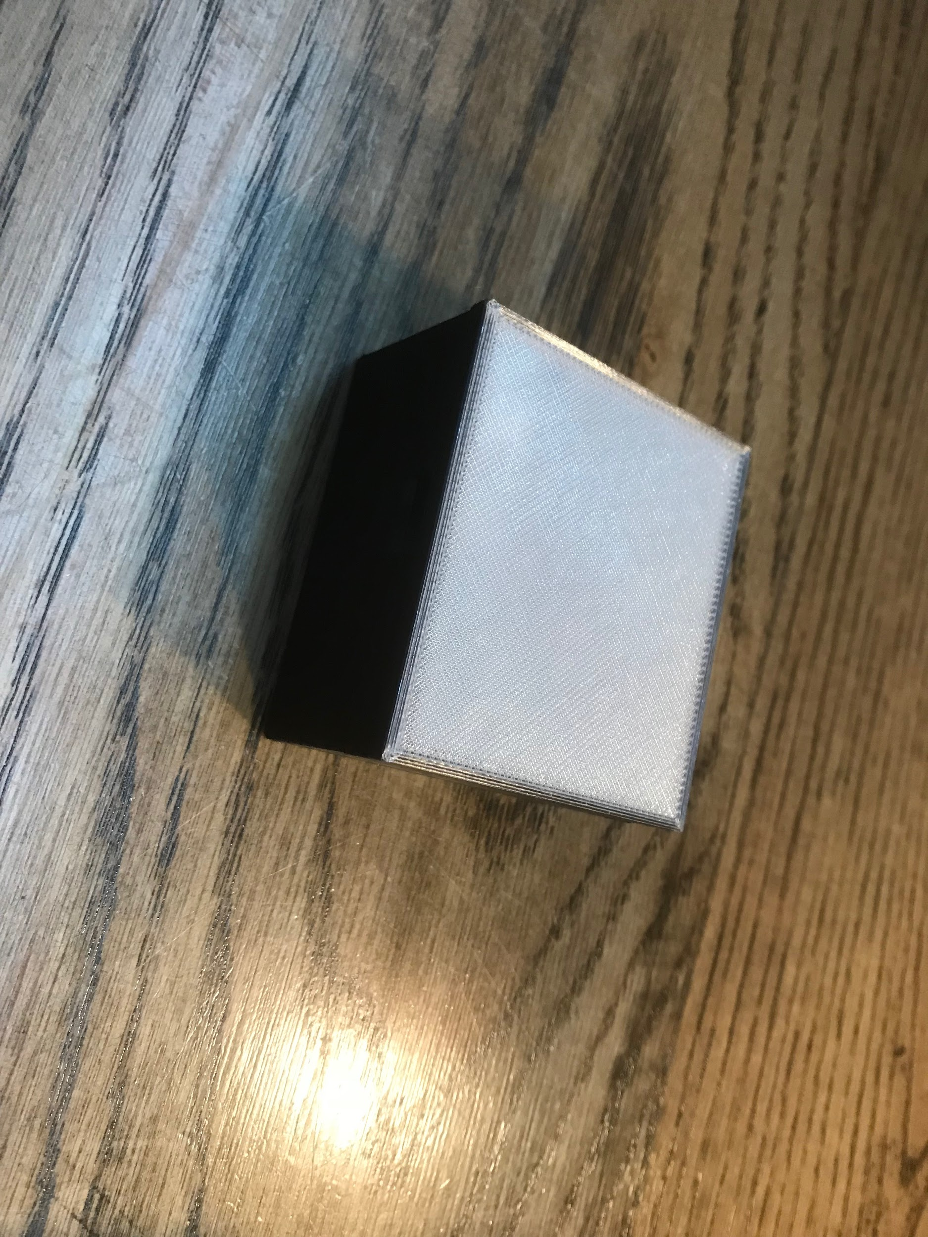
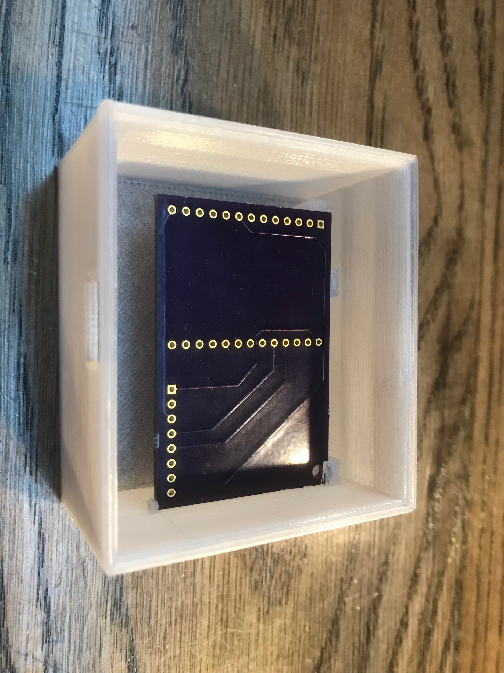
Presentation: Washing Machine Notifier

Slide 5
Washing Machine Notifier: Goals
Device to notify user when washing machine has finished and continue notification until user physical interaction.
Cheap - reasonably priced compared to problem’s pain
Quick - less than 2 week development
Self-contained - machine & company independent
Low power - multiple months between charges
IFTTT integration - user can choose notification type
Sellable - works out of box with little setup

Slide 6
Washing Machine Notifier: BOM
Description | Part Number | Supplier | Cost | Quantity | Total
Microprocessor | Lolin32 lite | Aliexpress | $4.90 | 1 | $4.90
Accelerometer | LIS3DH | Adafruit | $4.95 | 1 | $4.95
Battery | 2000mAh | Adafruit | $12.50 | 1 | $12.50
Motherboard |  | Oshpark | $4.95 | 1 | $4.95
Case |  | 3DHubs | $19.76 | 1 | $19.76
Magnets | 2448 | Amazon | $0.26 | 2 | $0.52
Headers | Female | Adafruit | $0.04 | 36 | $1.59
Headers | Male | Adafruit | $0.01 | 36 | $0.50
 |  |  |  |  | $49.66

Slide 7








Washing Machine Notifier: Tools
Arduino IDE
EasyEDA
Oshpark
TinkerCAD
3DHubs
IFTTT

Slide 8
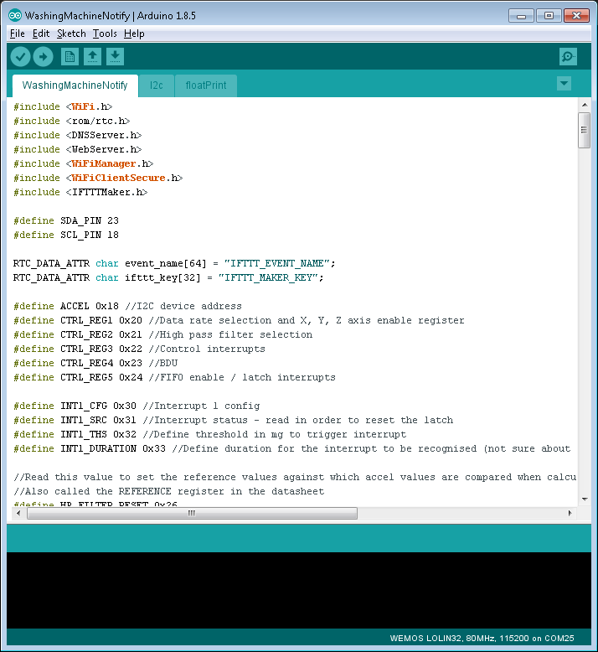
Washing Machine Notifier: Arduino
https://github.com/RuhtraRon/WashingMachineNotify
Lines: 381

Slide 9
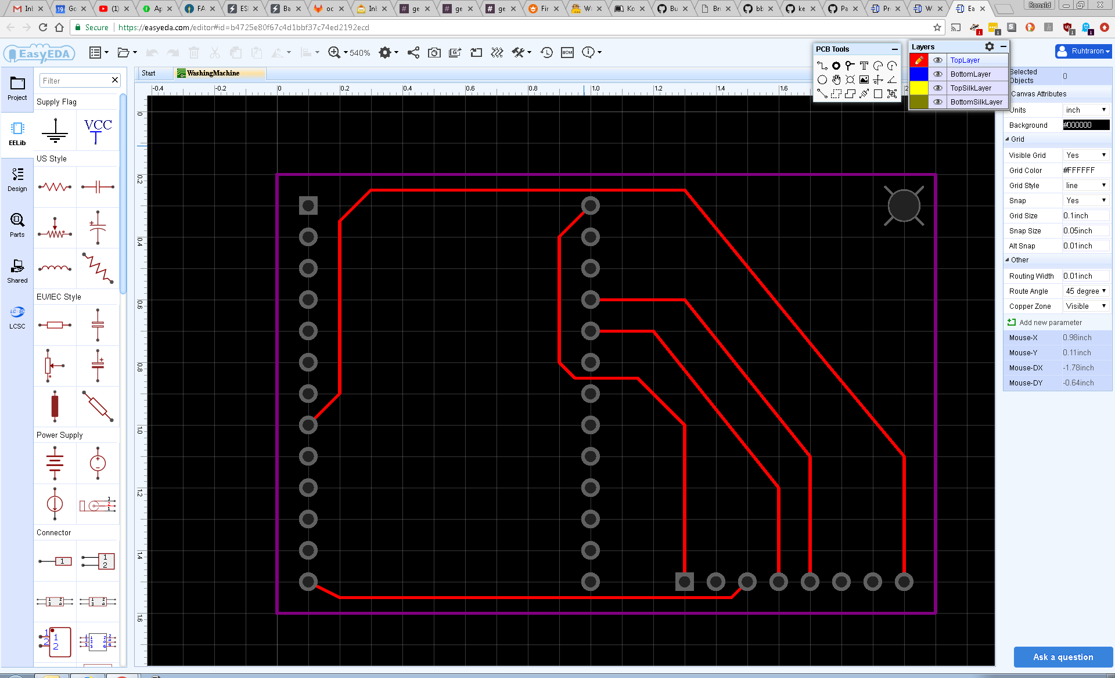
Washing Machine Notifier: EasyEDA

Slide 10

Washing Machine Notifier: Oshpark

Slide 11
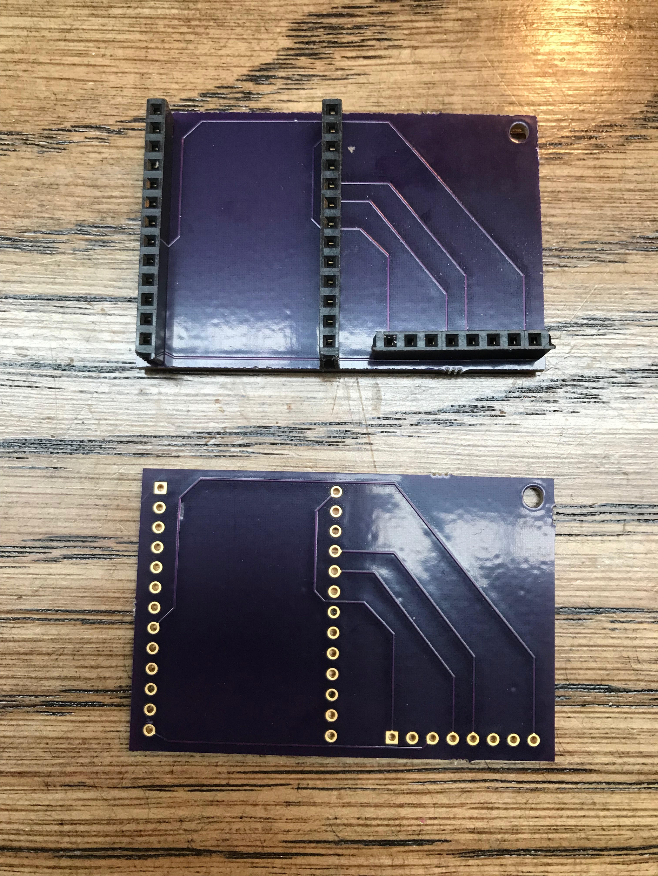
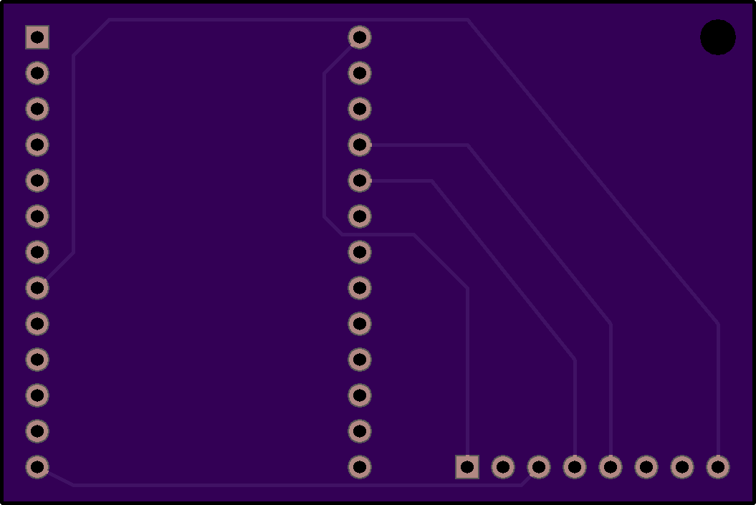
Washing Machine Notifier: Board

Slide 12
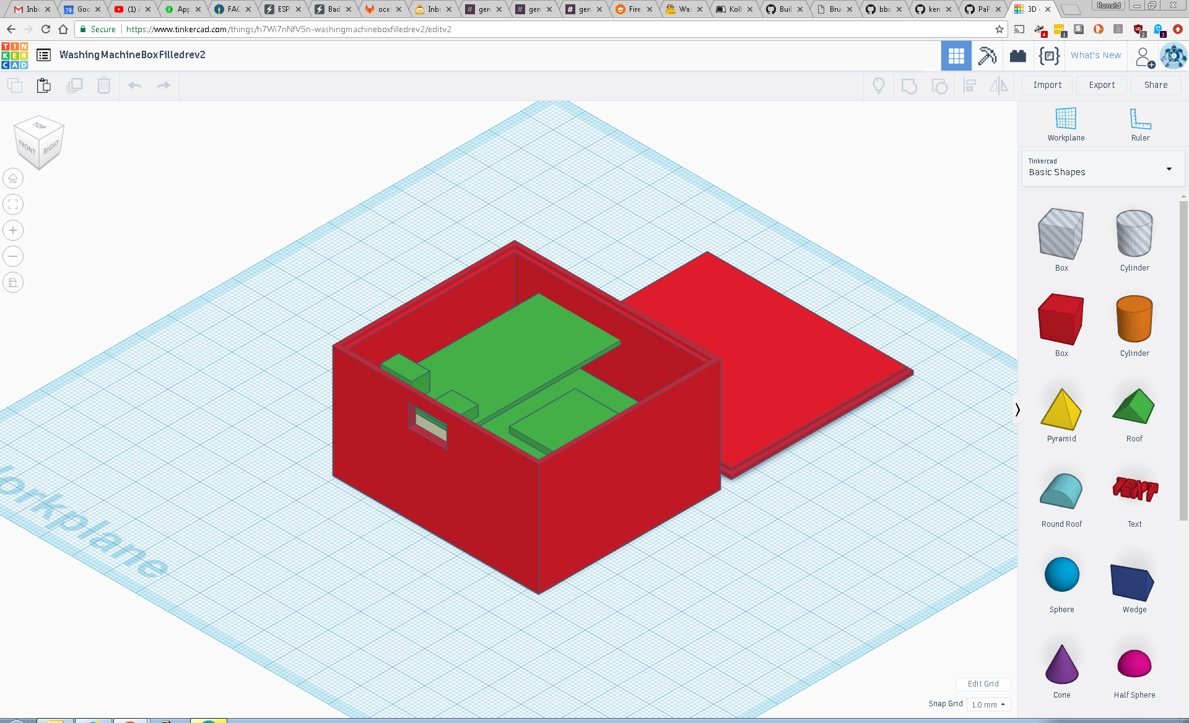
Washing Machine Notifier: TinkerCAD

Slide 13
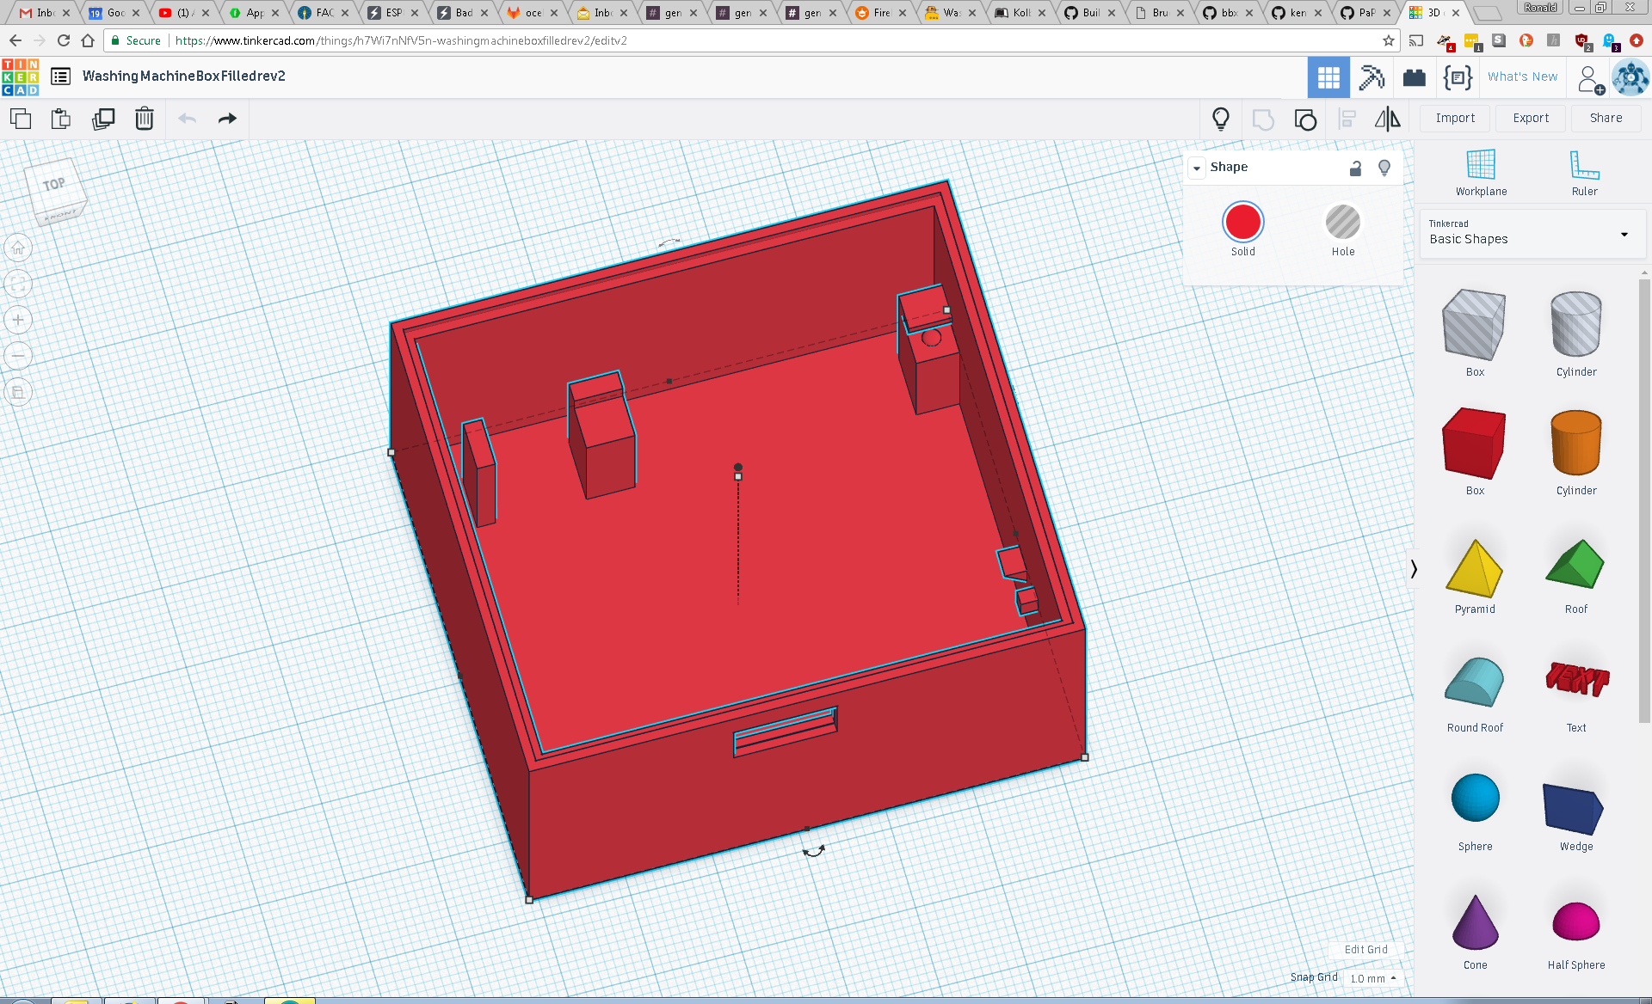
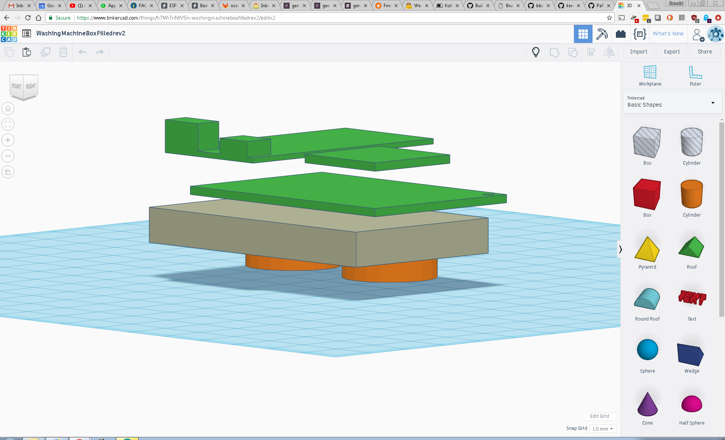
Washing Machine Notifier: TinkerCAD

Slide 14
Washing Machine Notifier: Case

Slide 15
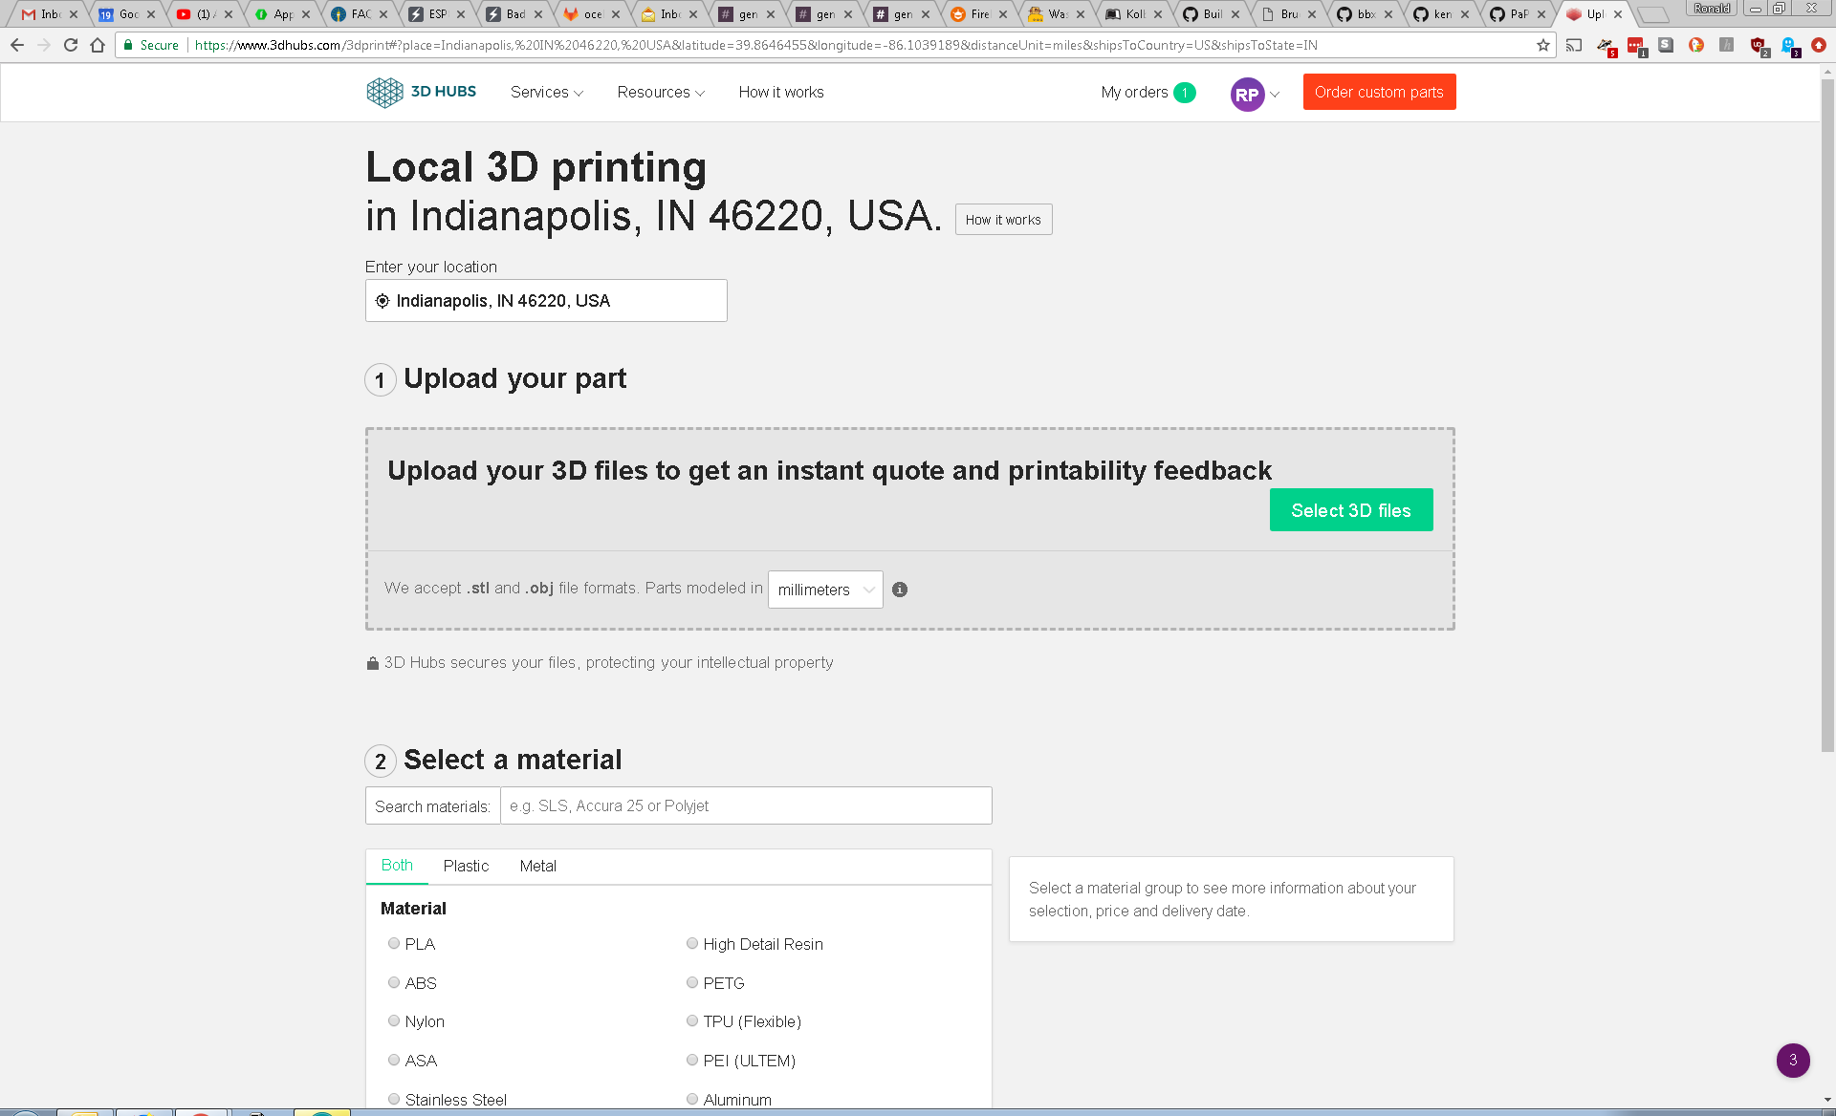
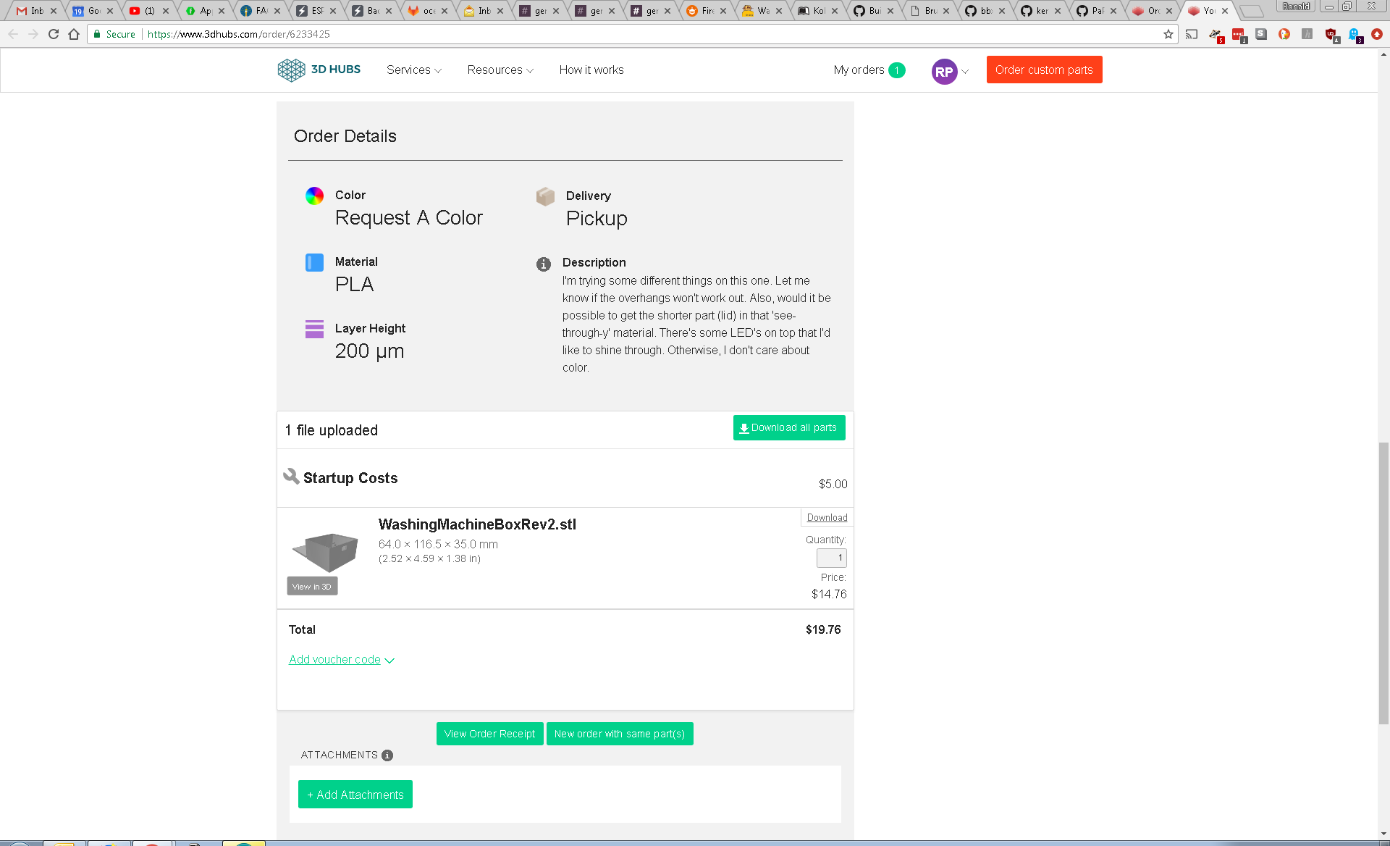
Washing Machine Notifier: 3DHubs

Slide 16

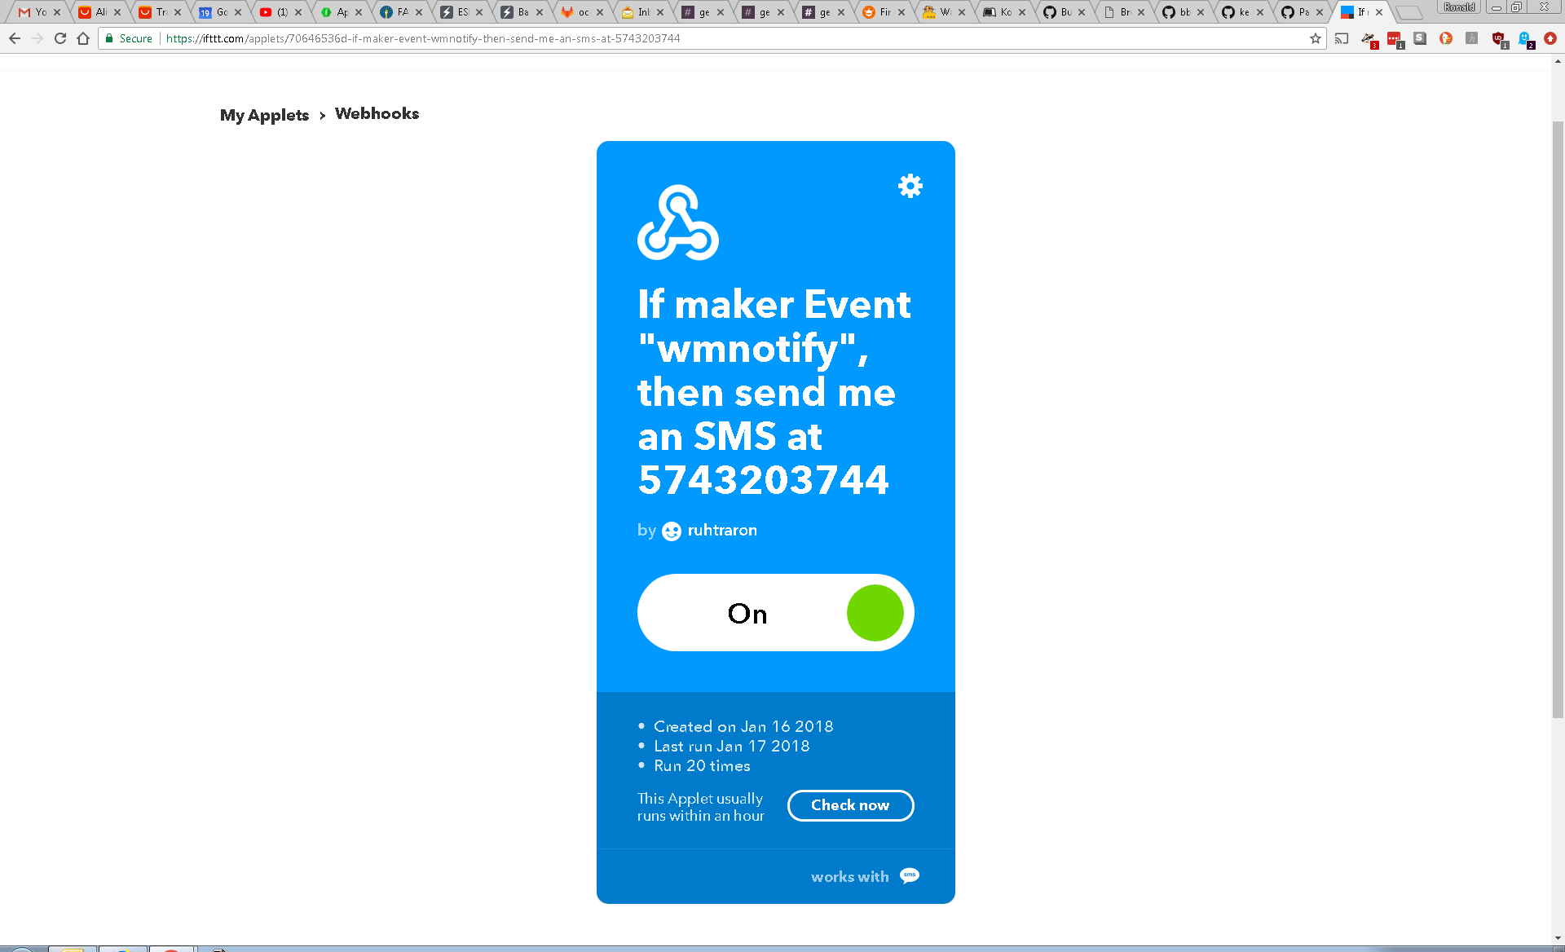
Washing Machine Notifier: IFTTT

Slide 17
Washing Machine Notifier: Questions?

Slide 18

indyopenhardware@gmail.com
@INOpenHardware
meetup.com/Indy-Open-Hardware-Meetup github.com/IndyOpenHardware

